Slide 1

Using GPT-4o for Disease Prediction
Google colab link:
https://colab.research.google.com/drive/14e1HZ3lzbdWIG-xMp5RpFsFwjYjFJEF7?usp=sharing
Github link:
https://github.com/akshayuta/LLM/tree/main

Slide 2
Dataset
We used the Synthea synthetic health records dataset (patients.csv + conditions.csv):
https://synthea.mitre.org/downloads
Generated data for 100+ patients
Includes demographic and diagnostic information
Hypertension label derived from conditions.csv

Slide 3
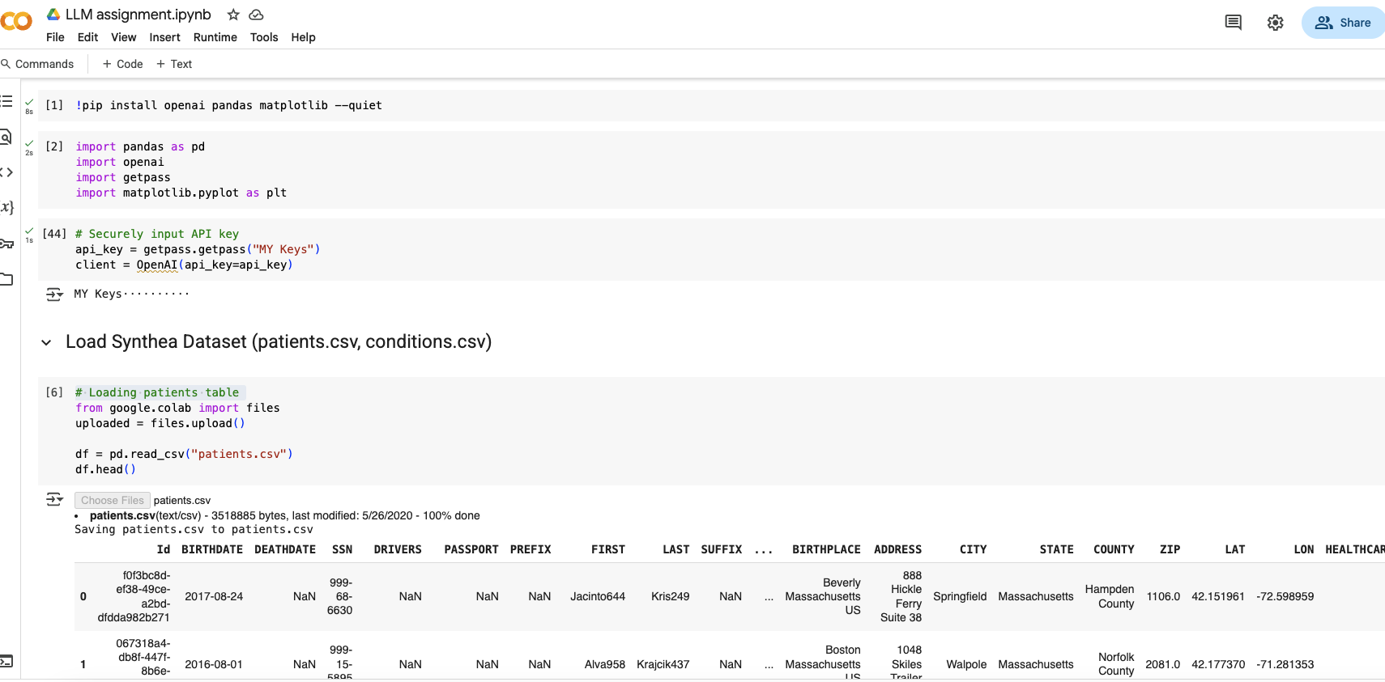

Slide 4
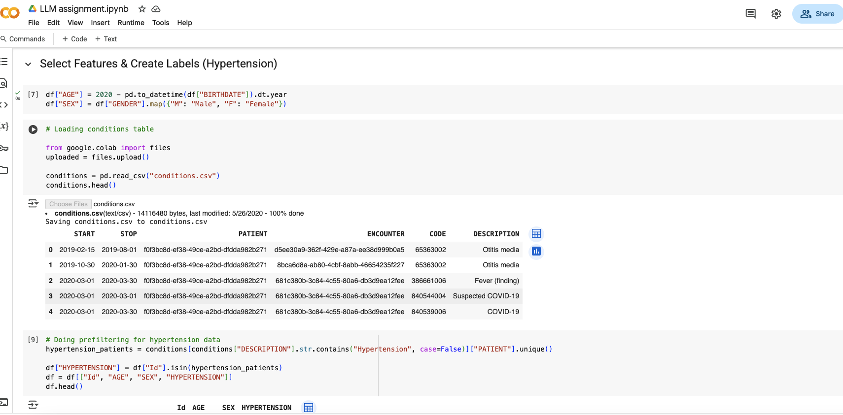

Slide 5
Prompt Engineering Strategy
Generated prompts with structured patient data in natural language.
Age, sex used as features
Chain-of-thought prompting: 'Explain step-by-step if patient has hypertension’
Improvements that could be made: Few-shot prompting planned for future versions

Slide 6
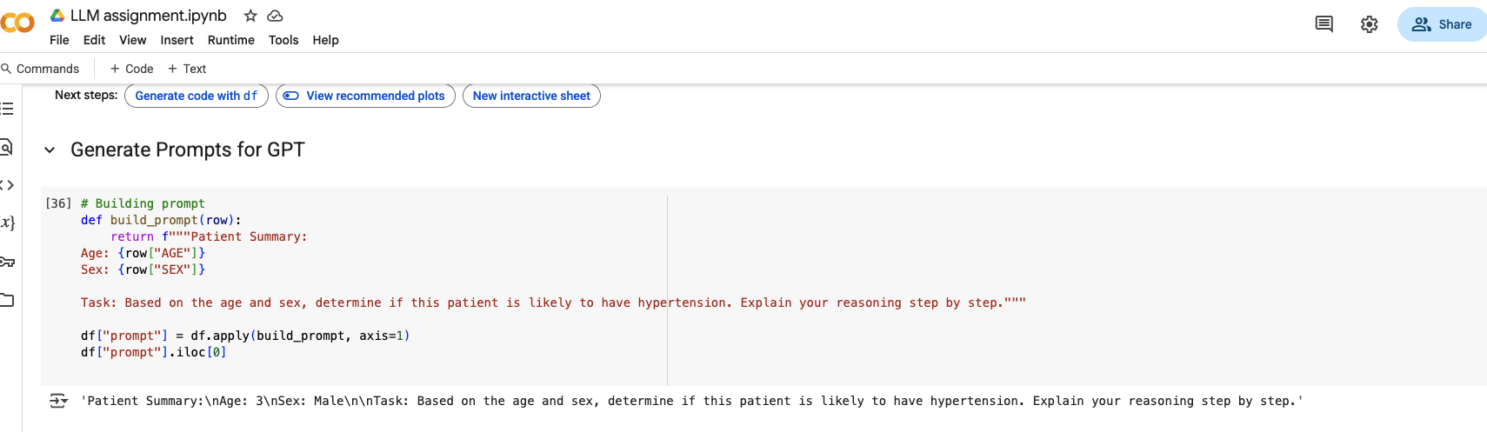

Slide 7
Model and API Setup
We used OpenAI's GPT-4o model via API with programmatic calls from Python.
Handled secure API key input
Constructed OpenAI client using `openai>=1.0.0`
Used `client.chat.completions.create()` for inference

Slide 8
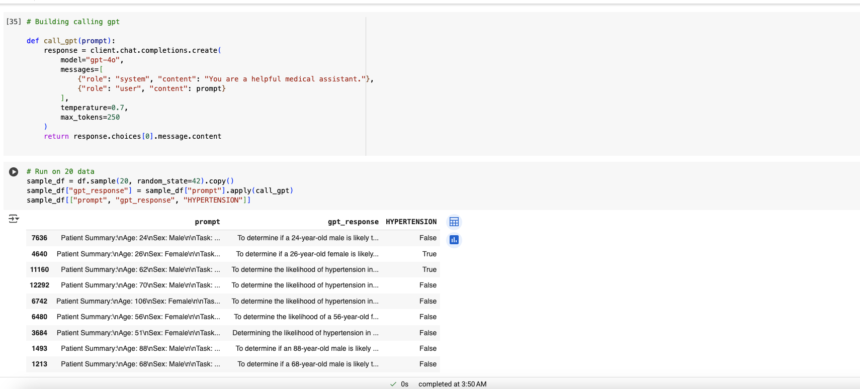

Slide 9
Sample GPT Output
Example (paraphrased):
'Given that the patient is 72 years old and male, they are likely to have hypertension.'
Output reflects natural reasoning
Can be useful for clinician or patient communication

Slide 10
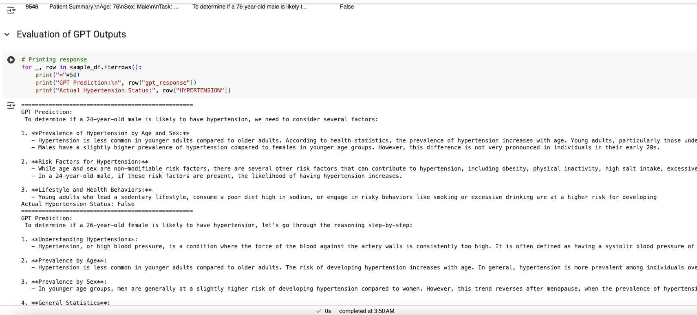

Slide 11
Accuracy Evaluation
We compared GPT predictions to actual labels from the dataset.
Accuracy 29.41% on sample set
Confusion matrix used for analysis
Ambiguous responses filtered out

Slide 12
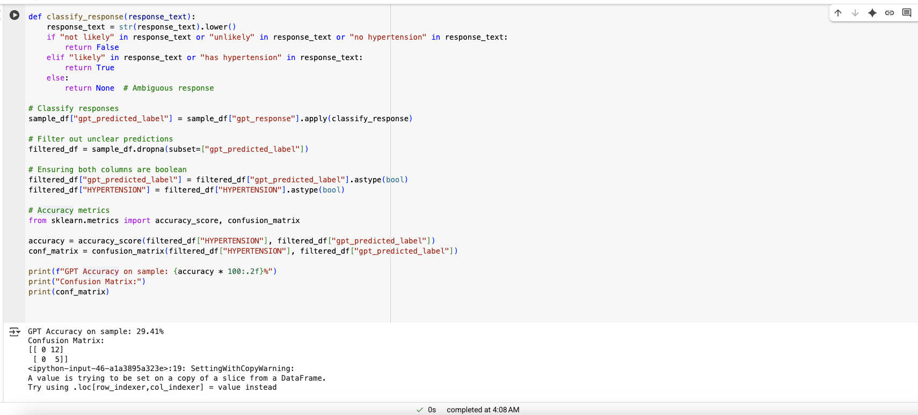

Slide 13
Future Work
Ways to improve and expand the approach:
Use more patient features: BMI, BP, cholesterol, medications
Incorporate few-shot or tree-of-thought prompting
Compare GPT-4o with other LLMs like MedAlpaca or PMC-LLaMA

Slide 14
Thank You!

